Slide 1
Chapter 3 Container Orchestration with Kubernetes

Slide 2
Learning Topics
Overview of Kubernetes
Kubernetes Architecture
Deploy Dockerized Apps
Persistent Storage
Health Checks
Secrets
Ingress
Stateful Sets
Horizontal Pod AutoScaler
Monitoring Kubernetes Cluster

Slide 3
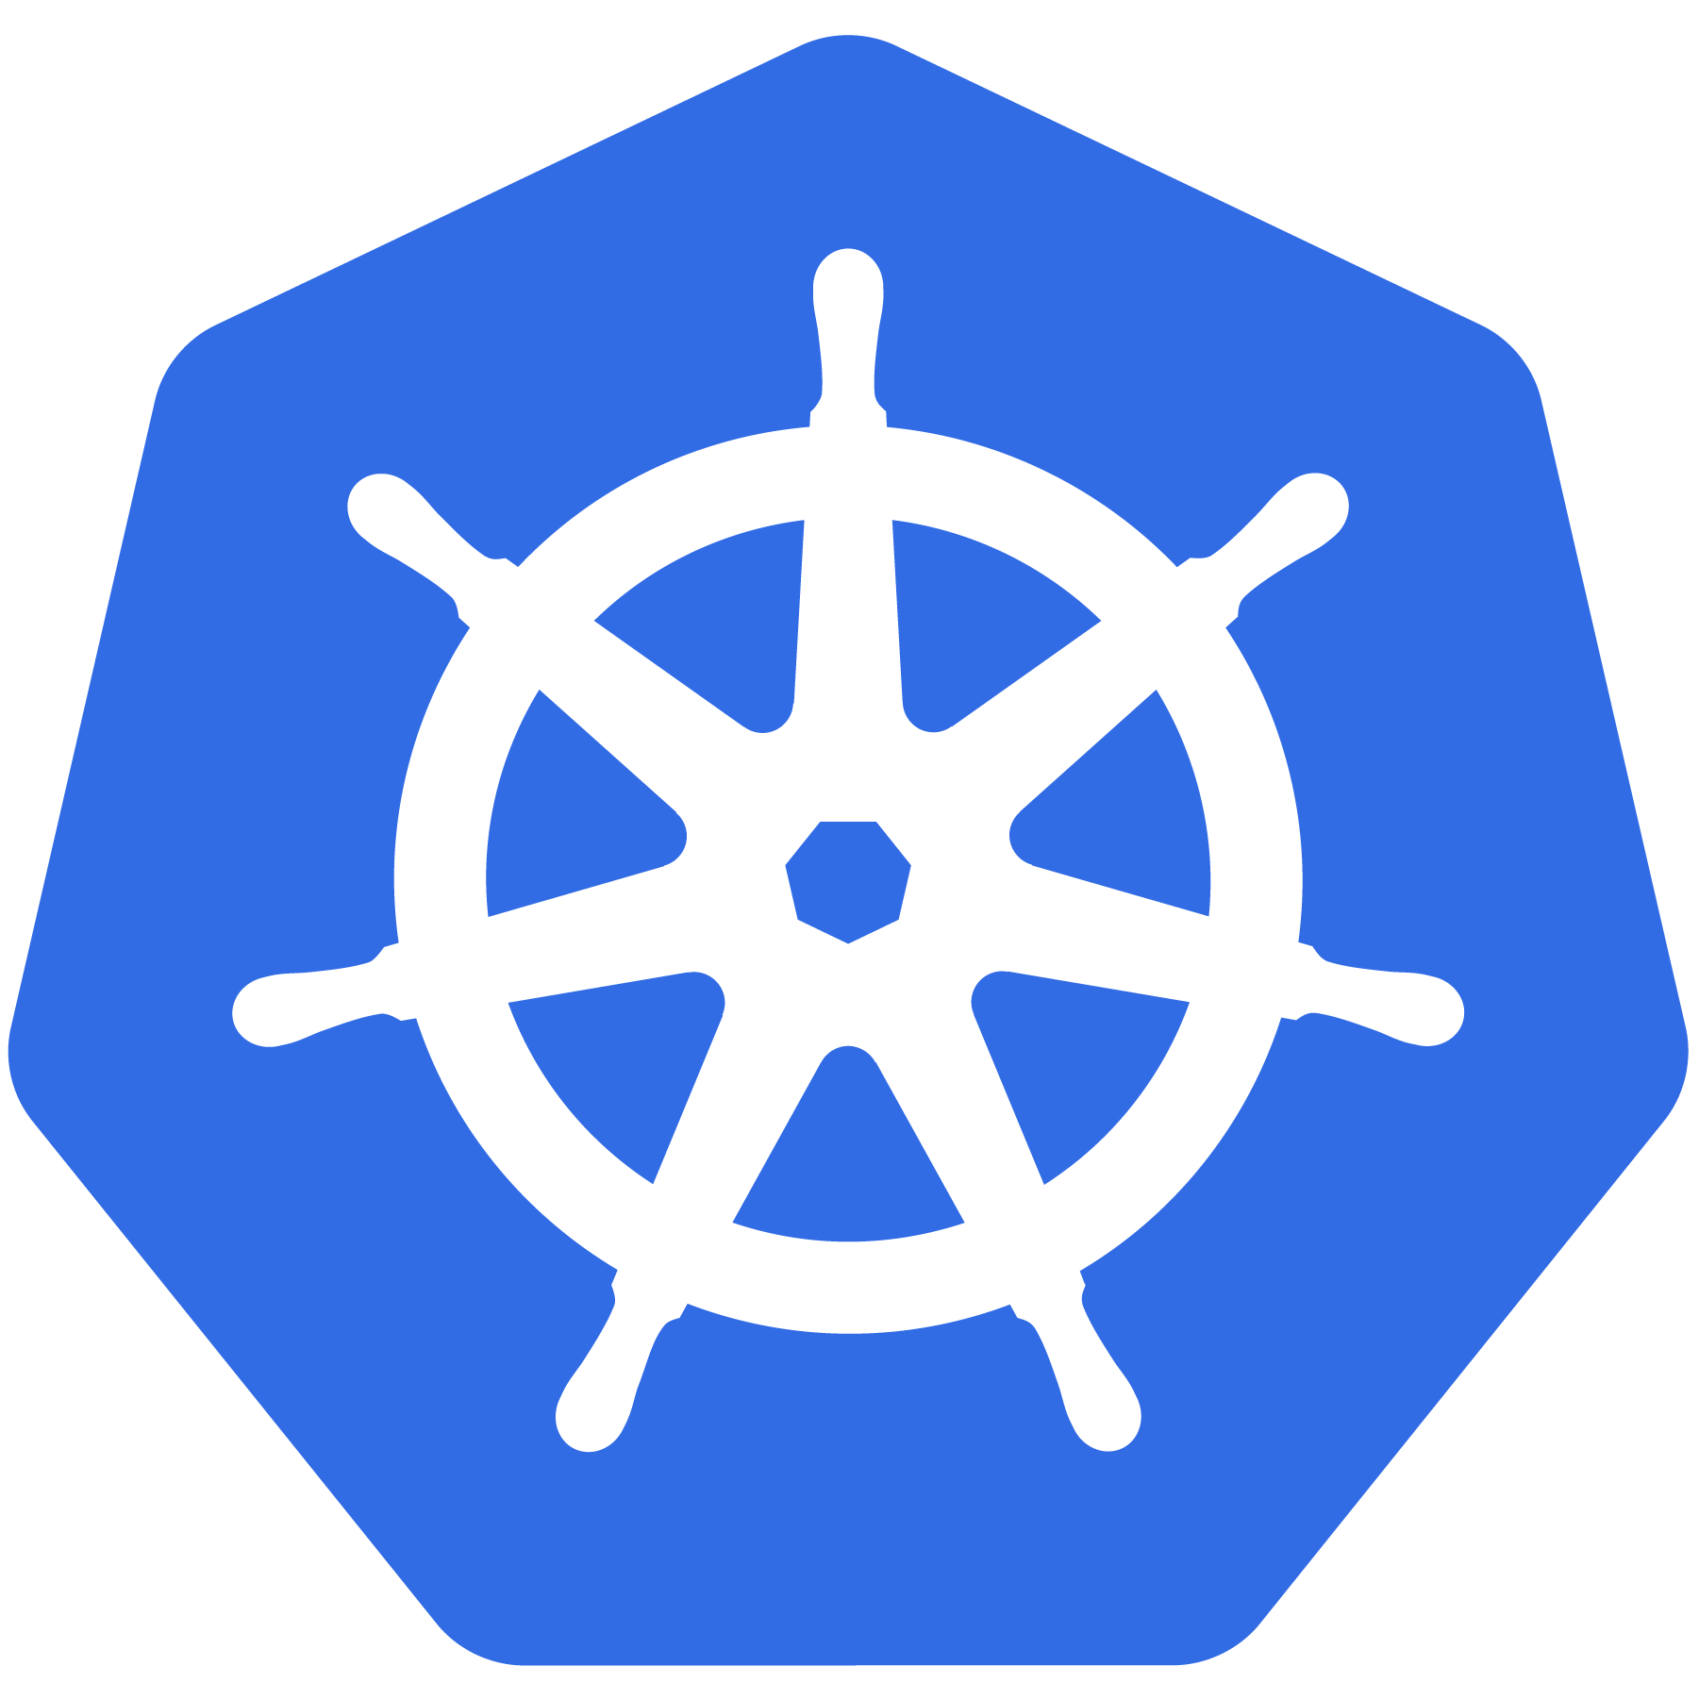

Kubernetes Meaning
Greek for “pilot” or
“Helmsman of a ship”

Slide 4
K8s History
Project that was spun out of Google as an open source container orchestration platform.
Built from the lessons learned in the experiences of developing and running Google’s Borg and Omega.
Designed from the ground-up as a loosely coupled collection of components centered around deploying, maintaining and scaling workloads.

Slide 5
K8s History
Contributors include Google, CodeOS, Redhat, Mesosphere, Microsoft, HP, IBM, VMWare, Pivotal, SaltStack etc.
Kubernetes is loosely coupled, meaning that all the components have little knowledge of each other and function independently.
This makes them easy to replace and integrate with a wide variety of systems
Written in Go Language

Slide 6

Who Manages Kubernetes
Sub-Foundation of Linux Foundation
A Vendor Neutral Entity to Manage “Cloud Native” Projects
Focused on
Containers
Dynamic Orchestration
Many More Services

Slide 7
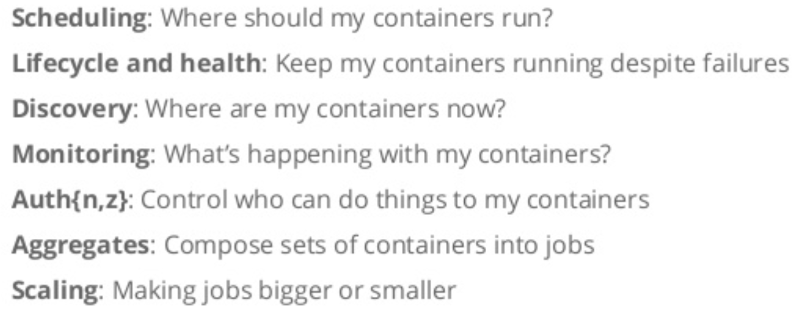
Container Issues

Slide 8
What Does Kubernetes Do?
Groups containers that make up an application into logical units for easy management and discovery
It acts as an engine for resolving state by converging actual and the desired state of the system
It is declarative, you tell it what you want it to be, and it figures it out
e.g. ‘I want 3 instances of x’ and it just does it, if something dies, it brings it back to get to 3

Slide 9
Most Popular Use Cases
Autoscale Workloads
Blue/Green Deployments
Scheduled Cronjobs
Manage Stateless Applications
Easily Integrate and Support 3rd Party Apps
Provide Native Methods of Service Discovery

Slide 10
Kubernetes Features
Kubernetes is an open-source system for
Automating Deployment
Scaling
Management
of containerized applications
Kubernetes can scale without increasing your ops team

Slide 11
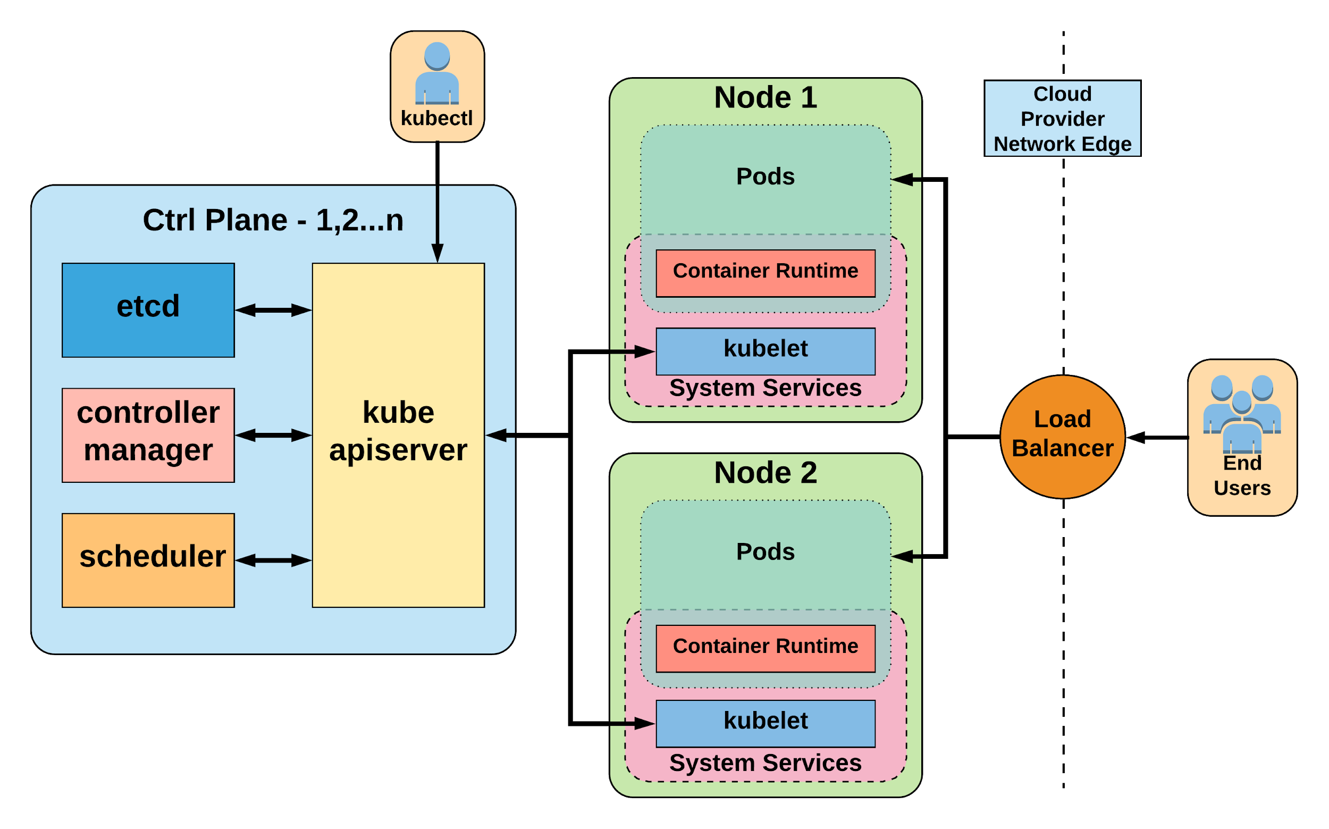
Kubernetes Architecture

Slide 12
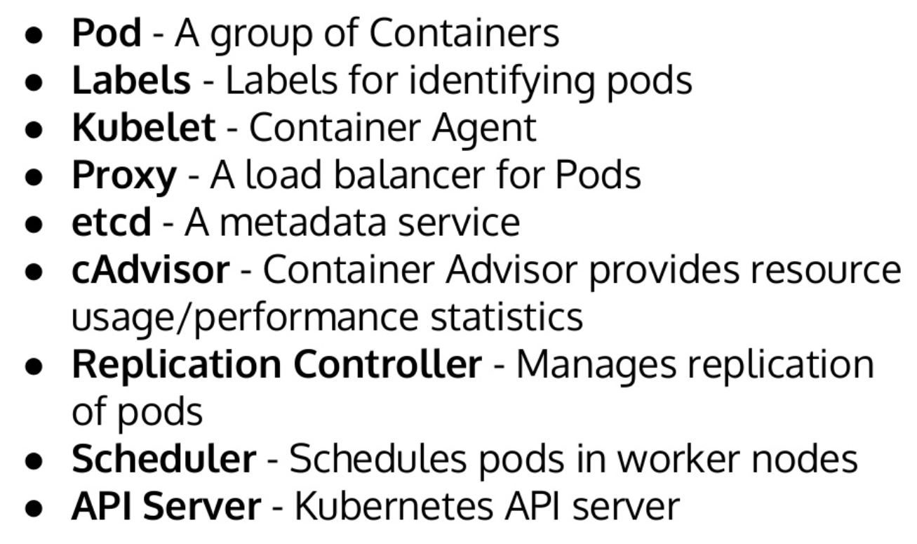
Key Terminologies

Slide 13
Core Concepts
Kubernetes has several core building blocks that make up the foundation of their higher level components.
Namespaces
Pods
Services
Labels
Selectors

Slide 14
Lab 1 – Deploy App on K8 Cluster
Deploy stateless application
Uses nginx image
Runs from Command Line Interface
Uses KubeCTL (Kubecontrol)

Slide 15
Kubernetes Objects

Slide 16
Kubernetes Objects
Persistent entities in the kubernetes system
Kubernetes uses these entities to represent the state of cluster
What containerized applications are running (and on which nodes)
The resources available to those applications
The policies around how those applications behave, such as restart policies, upgrades, and fault-tolerance

Slide 17
Kubernetes Objects Cont.
Record of Intent
Once object is created, kubernetes will constantly work to ensure that object exists
Tells about desired state of cluster
Need to use kubernetes API to create/modify/delete objects
Includes 2 nested object fields
Spec – You must provide, describes your desired state for the object
Status – Describes actual state of the object, supplied and updated by kubernetes

Slide 18
Describe Kubernetes Objects
Often, information is provided in a .yaml file to kubectl
Kubectl converts the information to JSON when making the API request.
Example Object
apiVersion: v1
kind: Pod
metadata:
name: pod-example
spec:
containers:
- name: nginx
image: nginx:stable-alpine
ports:
- containerPort: 80
Example Status Snippet
status:
conditions:
- lastProbeTime: null
lastTransitionTime: 2018-02-14T14:15:52Z
status: "True"
type: Ready
- lastProbeTime: null
lastTransitionTime: 2018-02-14T14:15:49Z
status: "True"
type: Initialized
- lastProbeTime: null
lastTransitionTime: 2018-02-14T14:15:49Z
status: "True"
type: PodScheduled

Slide 19
Replica Sets

Slide 20
Replica Sets
Primary method of managing pod replicas and their lifecycle
Includes their scheduling, scaling, and deletion.
Their job is simple: Always ensure the desired number of pods are running.
You define the number of pods you want running with the replicas field.
Pods are created with name based off replicaset name + random 5 character string

Slide 21
Replica Sets Cont.
apiVersion: apps/v1
kind: ReplicaSet
metadata:
name: rs-example
spec:
replicas: 3
selector:
matchLabels:
app: nginx env: prod
template:
metadata:
labels:
app: nginx
env: prod
spec:
containers:
- name: nginx
image: nginx:stable-alpine
ports:
- containerPort: 80
$ kubectl get pods
NAME READY STATUS RESTARTS AGE
rs-example-9l4dt 1/1 Running 0 1h
rs-example-b7bcg 1/1 Running 0 1h
rs-example-mkll2 1/1 Running 0 1h
$ kubectl describe rs rs-example
Name: rs-example
Namespace: default
Selector: app=nginx,env=prod
Labels: app=nginx
env=prod
Annotations: <none>
Replicas: 3 current / 3 desired
Pods Status: 3 Running / 0 Waiting / 0 Succeeded / 0 Failed
Pod Template:
Labels: app=nginx
env=prod
Containers:
nginx:
Image: nginx:stable-alpine
Port: 80/TCP
Environment: <none>
Mounts: <none>
Volumes: <none>
Events:
Type Reason Age From Message
---- ------ ---- ---- -------
Normal SuccessfulCreate 16s replicaset-controller Created pod: rs-example-mkll2
Normal SuccessfulCreate 16s replicaset-controller Created pod: rs-example-b7bcg
Normal SuccessfulCreate 16s replicaset-controller Created pod: rs-example-9l4dt

Slide 22
Deployments

Slide 23
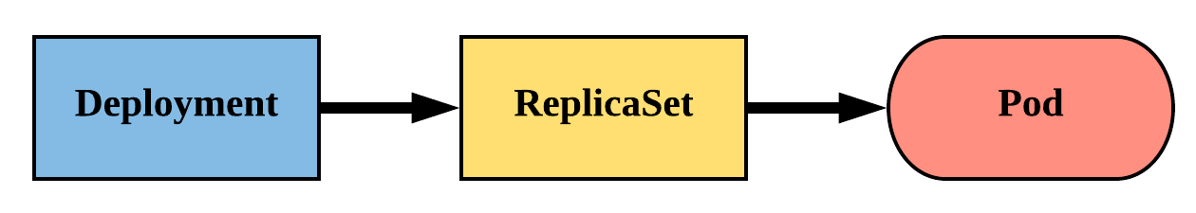
Deployments
Declarative method of managing Pods via ReplicaSets
Provides rollback functionality and update control
Updates are managed through the pod-template-hash label
Each iteration creates a unique label that is assigned to both the ReplicaSet and subsequent Pods

Slide 24
Deployments Cont.
revisionHistoryLimit: The number of previous iterations of the Deployment to retain.
strategy: Describes the method of updating the Pods based on the type. Valid options are Recreate or RollingUpdate.
Recreate: All existing Pods are killed before the new ones are created.
RollingUpdate: Cycles through updating the Pods according to the parameters: maxSurge and maxUnavailable.
maxSurge == how many ADDITIONAL replicas we want to spin up while updating
apiVersion: apps/v1
kind: Deployment
metadata:
name: deploy-example
spec:
replicas: 3 revisionHistoryLimit: 3
selector:
matchLabels:
app: nginx env: prod
strategy:
type: RollingUpdate
rollingUpdate:
maxSurge: 1
maxUnavailable: 0
template:
<pod template>

Slide 25
Lab 2 – Deploy App on K8 Cluster
Expose deployed app
NodePort and GKE Load Balancer

Slide 26
Control Plane Components
Kube-apiserver
Gate keeper for everything in kubernetes
EVERYTHING interacts with kubernetes through the apiserver
Etcd
Distributed storage back end for kubernetes
The apiserver is the only thing that talks to it
Kube-controller-manager
The home of the core controllers
Kube-scheduler
Handles placement

Slide 27
Kube-apiserver
Provides a forward facing REST interface into the kubernetes control plane and datastore.
All clients and other applications interact with kubernetes strictly through the API Server.
Handles authn, authz, request validation, mutation and admission control and serves as a generic front end to the backing datastore

Slide 28
etcd
etcd acts as the cluster datastore.
Purpose in relation to Kubernetes is to provide a strong, consistent, highly durable and highly available key-value store for persisting cluster state.
Stores objects and config information.

Slide 29
Kube-controller-manager
Its the director behind the scenes
Serves as the primary daemon that manages all core component control loops.
Monitors the cluster state via the apiserver and steers the cluster towards the desired state.
Does NOT handle scheduling, just decides what the desired state of the cluster should look like
e.g. receives request for a deployment, produces replicaset, then produces pods

Slide 30
Kube-scheduler
Scheduler decides which nodes should run which pods
Serves as the primary daemon that manages all core component control loops.
Monitors the cluster state via the apiserver and steers the cluster towards the desired state.
Does NOT handle scheduling, just decides what the desired state of the cluster should look like
e.g. receives request for a deployment, produces replicaset, then produces pods

Slide 31
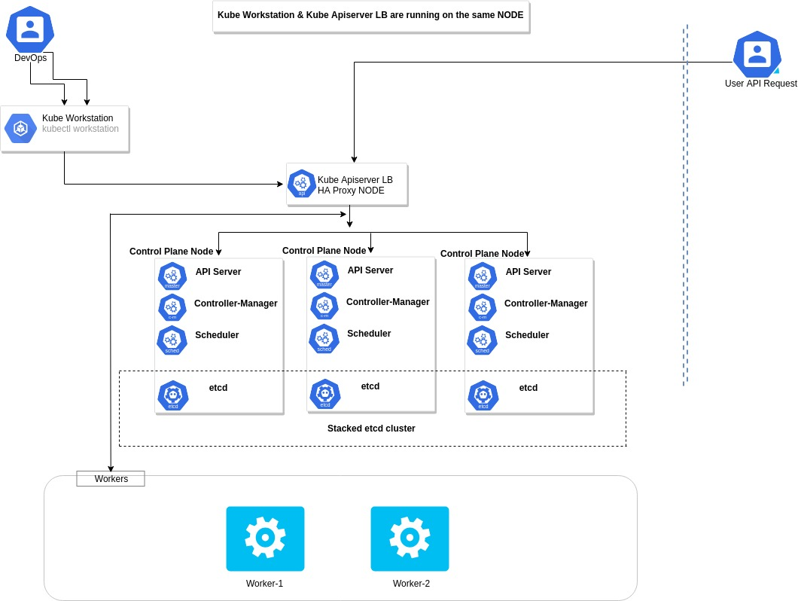
HA Cluster Architecture

Slide 32
Lab 3 – Deploy Dockerized .Net App
Deploy Dockerized .Net App
Use Image in Your Own Docker Registry
Expose deployed app on NodePort

Slide 33
Assignment
Change text in output
Deploy on K8 cluster

Slide 34
Assignment - Steps
Change code
Create image with same name and new version (v2)
Upload this new image to Docker Hub
Update deployment.yaml, use v2 image
Delete existing deployment
Create new deployment

Slide 35
Node Components
Kubelet
Agent running on every node, including the control plane
Kube-proxy
The network ‘plumber’ for Kubernetes services
Enables in-cluster load-balancing and service discovery
Container Runtime Engine
The containerizer itself - typically docker

Slide 36
Pods
Smallest Unit of Work
Collection of One or More Containers
Share Volumes, Network Namespace
Part of Single Context, Managed Together
Ephemeral in Nature

Slide 37
Kubelet
Acts as the node agent responsible for managing the lifecycle of every pod on its host.
Kubelet understands YAML container manifests that it can read from several sources:
file path
HTTP Endpoint
etcd watch acting on any changes
HTTP Server mode accepting container manifests over a simple API.
The single host daemon required for a being a part of a kubernetes cluster

Slide 38
Kube-proxy
Manages the network rules on each node.
Performs connection forwarding or load balancing for Kubernetes cluster services.
Creates the rules on the host to map and expose services
Available Proxy Modes:
Userspace
iptables
ipvs (default if supported)

Slide 39
Container Runtime Engine
A container runtime is a CRI (Container Runtime Interface) compatible application that executes and manages containers.
Containerd (docker)
Kubernetes functions with multiple different containerizers
Interacts with them through the CRI - container runtime interface
CRI creates a ‘shim’ to talk between kubelet and the container runtime

Slide 40
API Server

Slide 41
API Overview
The REST API (API-Server) is the keystone of Kubernetes
Every component communicates with API-Server
Everything within Kubernetes is an API Object
Object Oriented Application Architecture

Slide 42
API Groups
Every object in kubernetes belongs to an API Group
The API Group is a REST compatible path
Format:
/apis/<group>/<version>/<resource>
Examples:
/apis/apps/v1/deployments
/apis/batch/v1beta1/cronjobs

Slide 43
API Versioning
3 tiers of API Maturity Level
Alpha – May be buggy, disabled by default
Beta – Code is well tested, enabled by default
Stable – Released, stable and API schema will not change.
https://kubernetes.io/docs/concepts/overview/kubernetes-api/#api-versioning

Slide 44
ConfigMap & Secrets

Slide 45
Configuration
Kubernetes has an integrated pattern for decoupling configuration from application or container.
This pattern makes use of two Kubernetes components: ConfigMaps and Secrets.

Slide 46
ConfigMap
Externalized data stored within kubernetes.
Can be referenced through several different means:
environment variable
a command line argument (via env var)
injected as a file into a volume mount
Can be created from a manifest, literals, directories, or files directly.

Slide 47
Secret
Functionally identical to a ConfigMap.
Stored as base64 encoded content.
Encrypted at rest within etcd (if configured!).
Ideal for username/passwords, certificates or other sensitive information that should not be stored in a container.
Can be created from a manifest, literals, directories, or from files directly.

Slide 48
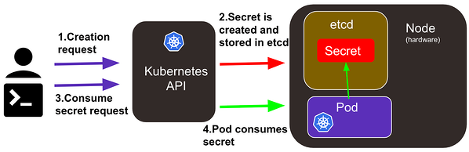
Secret
Kubernetes secret objects let you store and manage sensitive information
Users can create secrets, and the system also creates some secrets.
A secret can be used with a pod in two ways:
as files in a volume mounted on one or more of its containers
used by kubelet when pulling images for the pod

Slide 49
Lab 4 – Kubernetes Secrets

Slide 50
Storage Options

Slide 51
Storage
Many workloads require exchanging data between containers, or persisting some form of data
4 types of storage
Volumes
Persistent Volumes
Persistent Volume Claims
Storage Classes

Slide 52
Persistent Volume
A PersistentVolume (PV) represents a storage resource
PVs are a cluster wide resource linked to a backing storage provider: NFS, GCEPersistentDisk, RBD etc.
Generally provisioned by an administrator
Their lifecycle is handled independently from a pod
CANNOT be attached to a Pod directly. Relies on a PersistentVolumeClaim

Slide 53
Persistent Volume Cont.
You define the capacity, whether you want a filesystem or a block device, and the access mode
RWO - only a single pod will be able to (through a PVC) mount this.
ROM - many pods can mount this, but none can write.
RWM - many pods can mount and write.
apiVersion: v1
kind: PersistentVolume
metadata:
name: nfsserver
spec:
capacity:
storage: 50Gi
volumeMode: Filesystem
accessModes:
- ReadWriteOnce
- ReadWriteMany
persistentVolumeReclaimPolicy: Delete
storageClassName: slow mountOptions:
- hard
- nfsvers=4.1
nfs:
path: /exports
server: 172.22.0.42

Slide 54
Persistent Volume Claims
A PersistentVolumeClaim (PVC) is a namespace request for storage.
Satisfies a set of requirements instead of mapping to a storage resource directly.
Ensures that an application’s ‘claim’ for storage is portable across numerous backends or providers.
PVCs can be named the same to make things consistent but point to different storage classes

Slide 55
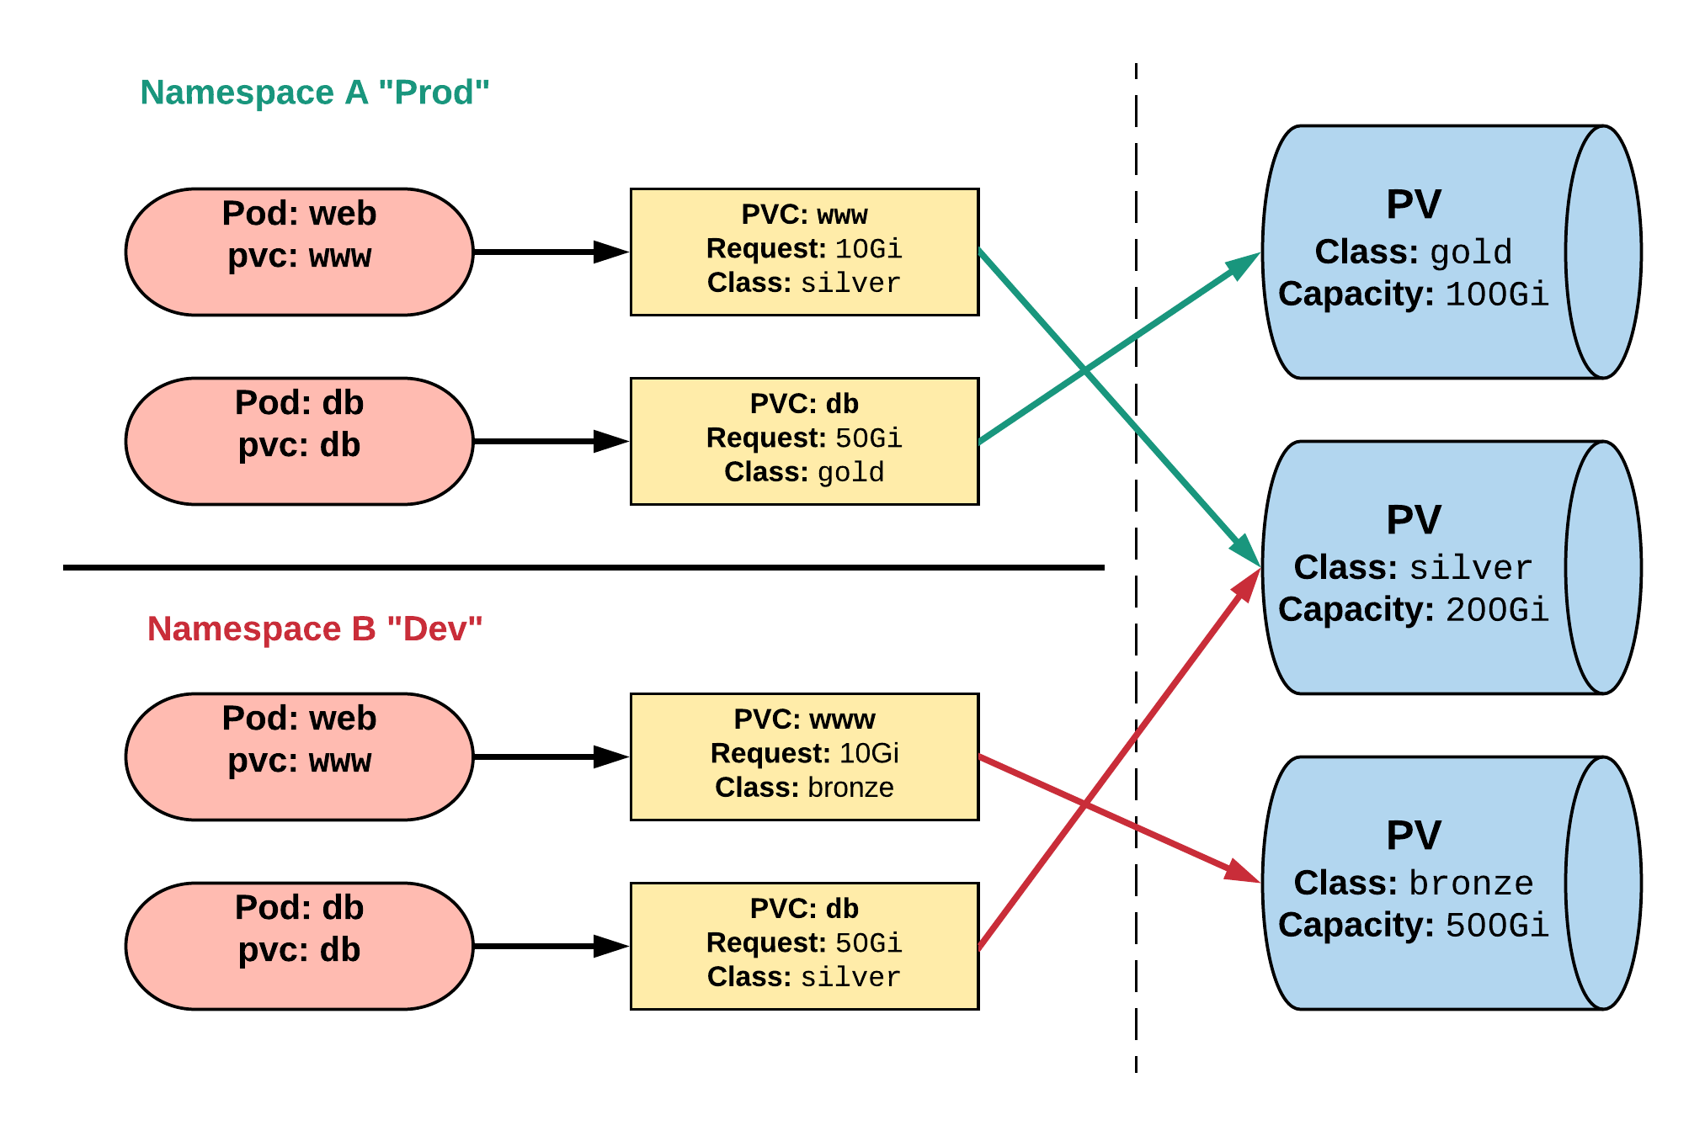
Persistent Volume & Claims
Cluster Users
Cluster Admins

Slide 56
Persistent Volume Phases
Available
PV is ready and available to be consumed.
Bound
The PV has been bound to a claim.
Released
The binding PVC has been deleted, and the PV is pending reclamation.
Failed
An error has been encountered attempting to reclaim the PV.

Slide 57
Lab 5 – Persistent Storage
Create a Persistent Volume (PV)
Create a Persistent Volume Claim
Store Data in PV from a Pod
Access Same Data from Another Pod

Slide 58
Kubernetes Health Checks
Readiness Probe :
Designed to let Kubernetes know when your app is ready to serve traffic
Kubernetes makes sure the readiness probe passes before allowing a service to send traffic to the pod
If a readiness probe starts to fail, Kubernetes stops sending traffic to the pod until it passes
Useful for startup and load management
Transient in nature and tells Kubernetes to route traffic elsewhere

Slide 59
Kubernetes Health Checks
Liveness Probe :
Designed to let Kubernetes know if your app is dead or alive
If you app is alive, then Kubernetes leaves it alone
If your app is dead, Kubernetes removes the Pod and starts a new one to replace it

Slide 60
Lab 6 – K8 Health Checks
Configure Liveness Probe
Configure Readiness Probe

Slide 61
Rolling Update Deployments

Slide 62
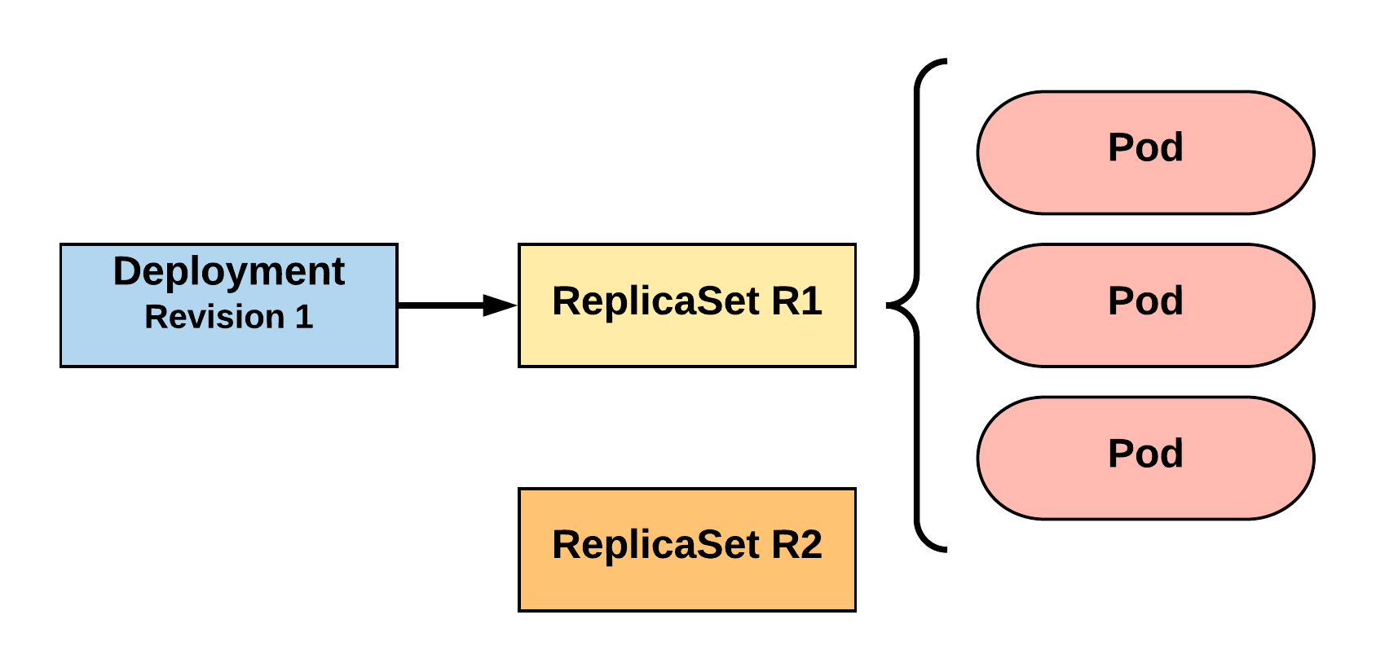
RollingUpdate Deployment
Updating pod template generates a new ReplicaSet revision.
R1 pod-template-hash: 676677fff
R2 pod-template-hash: 54f7ff7d6d
$ kubectl get replicaset
NAME DESIRED CURRENT READY AGE
mydep-6766777fff 3 3 3 5h
$ kubectl get pods
NAME READY STATUS RESTARTS AGE
mydep-6766777fff-9r2zn 1/1 Running 0 5h
mydep-6766777fff-hsfz9 1/1 Running 0 5h
mydep-6766777fff-sjxhf 1/1 Running 0 5h
Notes:
We add a new label, change the image, do something to change the pod template in some way
The deployment controller creates a new replicaset with 0 instances to start

Slide 63
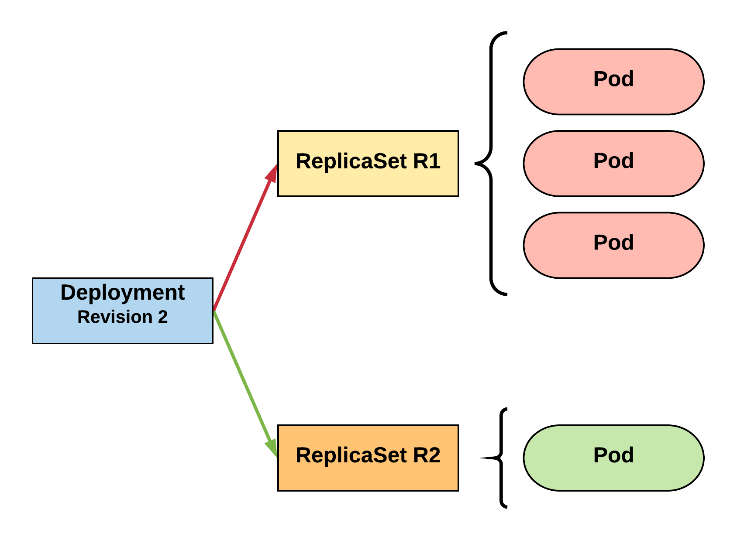
RollingUpdate Deployment
New ReplicaSet is initially scaled up based on maxSurge.
R1 pod-template-hash: 676677fff
R2 pod-template-hash: 54f7ff7d6d
$ kubectl get replicaset
NAME DESIRED CURRENT READY AGE mydep-54f7ff7d6d 1 1 1 5s
mydep-6766777fff 2 3 3 5h
$ kubectl get pods
NAME READY STATUS RESTARTS AGE
mydep-54f7ff7d6d-9gvll 1/1 Running 0 2s
mydep-6766777fff-9r2zn 1/1 Running 0 5h
mydep-6766777fff-hsfz9 1/1 Running 0 5h
mydep-6766777fff-sjxhf 1/1 Running 0 5h
Notes:
It then scales up the new ReplicaSet based on our maxSurge value

Slide 64
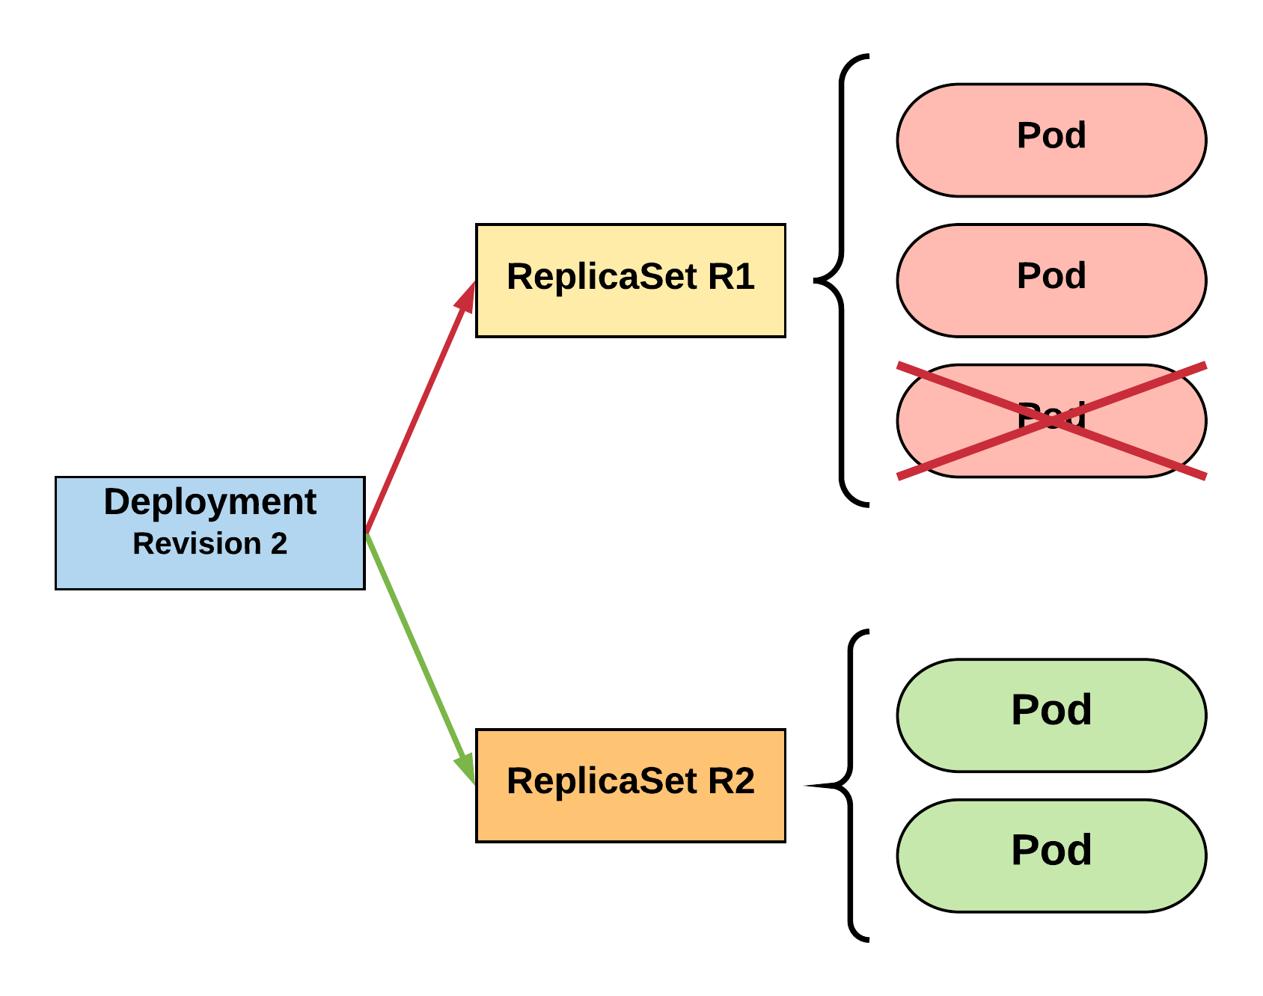
RollingUpdate Deployment
Phase out of old Pods managed by maxSurge and maxUnavailable.
R1 pod-template-hash: 676677fff
R2 pod-template-hash: 54f7ff7d6d
$ kubectl get replicaset
NAME DESIRED CURRENT READY AGE mydep-54f7ff7d6d 2 2 2 8s
mydep-6766777fff 2 2 2 5h
$ kubectl get pods
NAME READY STATUS RESTARTS AGE
mydep-54f7ff7d6d-9gvll 1/1 Running 0 5s
mydep-54f7ff7d6d-cqvlq 1/1 Running 0 2s
mydep-6766777fff-9r2zn 1/1 Running 0 5h
mydep-6766777fff-hsfz9 1/1 Running 0 5h
Notes:
It will then begin to kill off the prevision revision by scaling down the old replicaset and scaling up the new one

Slide 65
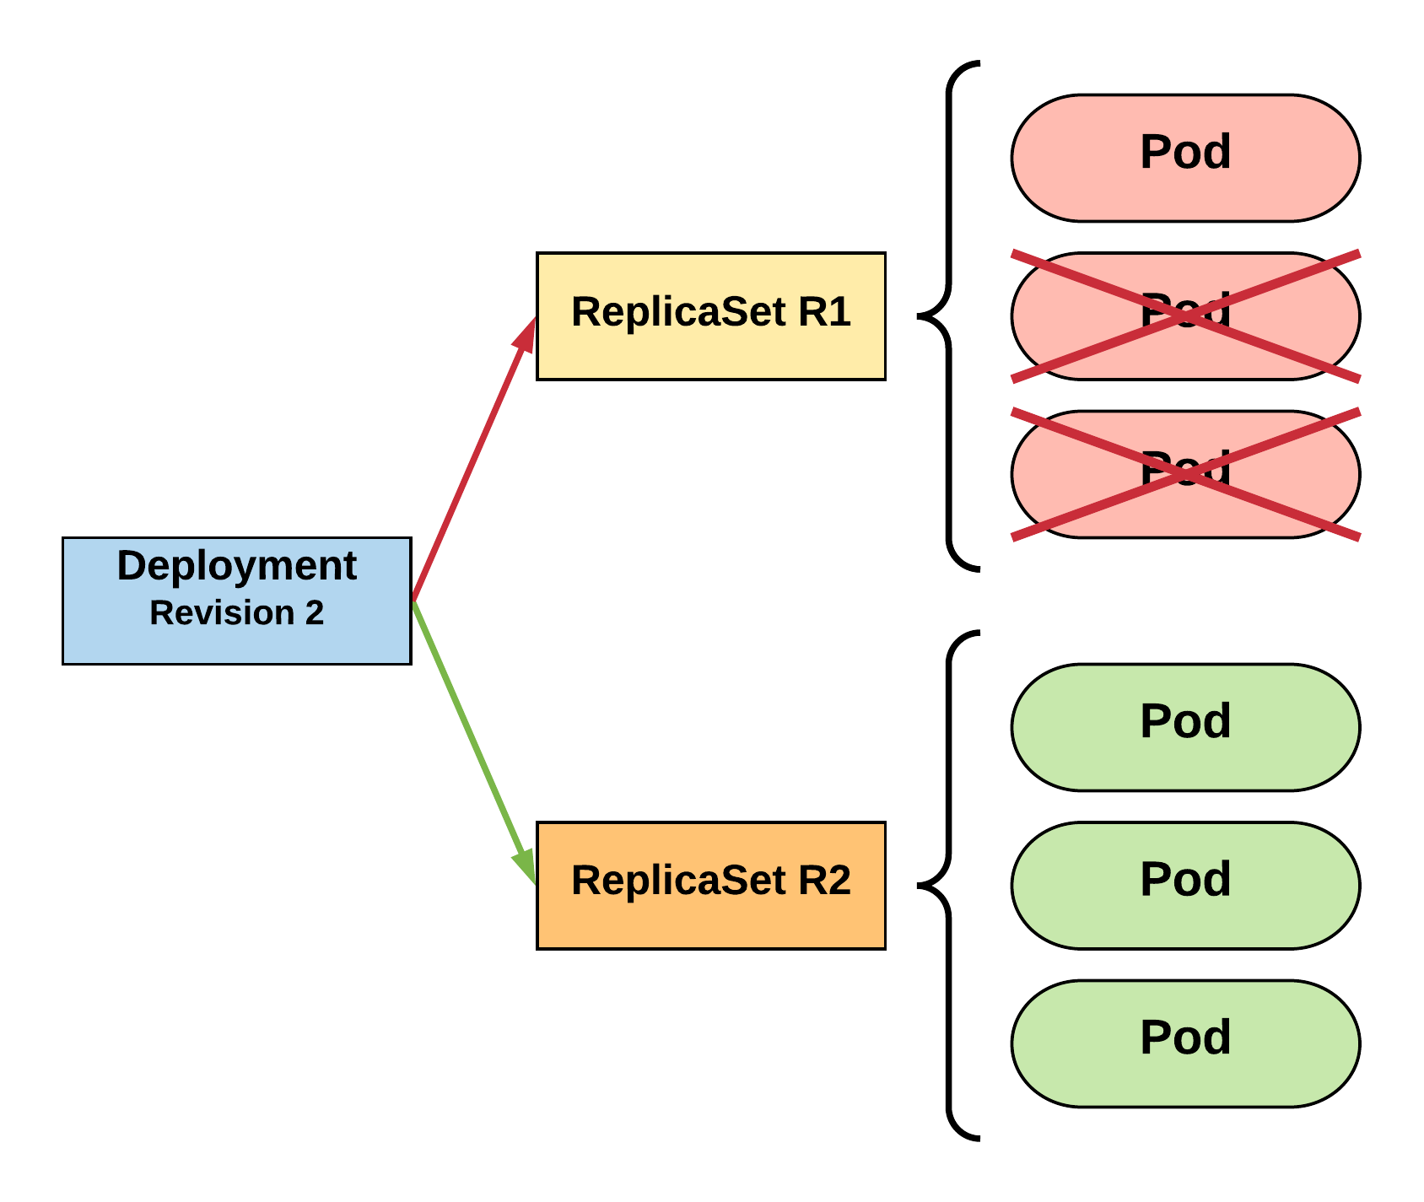
RollingUpdate Deployment
Phase out of old Pods managed by maxSurge and maxUnavailable.
R1 pod-template-hash: 676677fff
R2 pod-template-hash: 54f7ff7d6d
$ kubectl get replicaset
NAME DESIRED CURRENT READY AGE mydep-54f7ff7d6d 3 3 3 10s
mydep-6766777fff 0 1 1 5h
$ kubectl get pods
NAME READY STATUS RESTARTS AGE
mydep-54f7ff7d6d-9gvll 1/1 Running 0 7s
mydep-54f7ff7d6d-cqvlq 1/1 Running 0 5s
mydep-54f7ff7d6d-gccr6 1/1 Running 0 2s
mydep-6766777fff-9r2zn 1/1 Running 0 5h
Notes:
Continues this pattern based on maxSurge and maxUnavailable

Slide 66
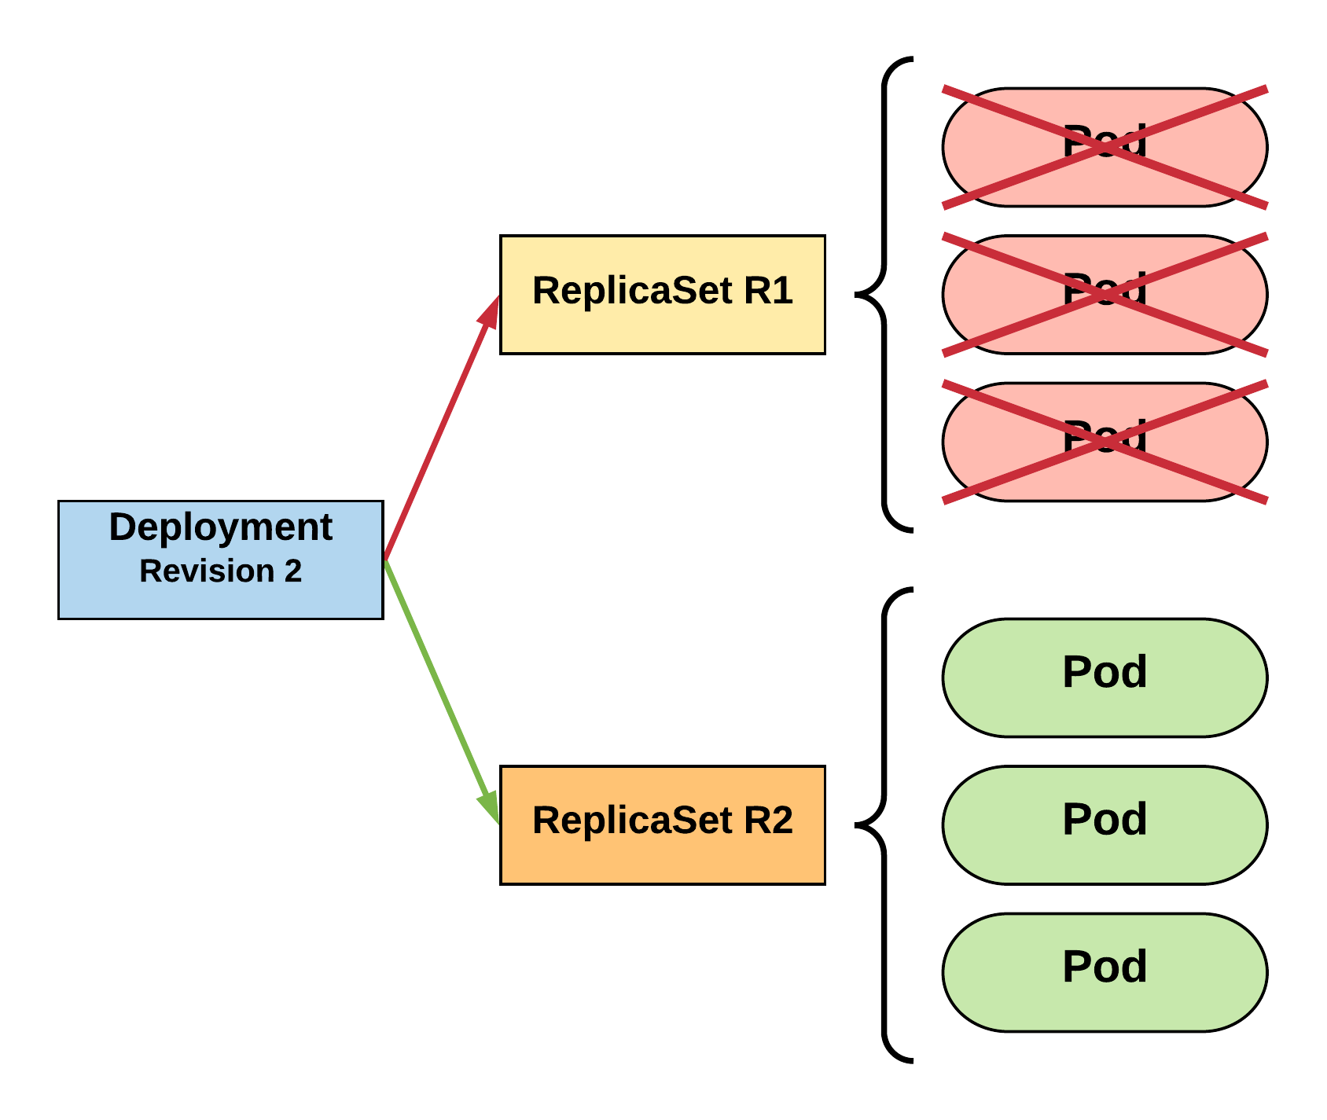
RollingUpdate Deployment
Phase out of old Pods managed by maxSurge and maxUnavailable.
R1 pod-template-hash: 676677fff
R2 pod-template-hash: 54f7ff7d6d
$ kubectl get replicaset
NAME DESIRED CURRENT READY AGE
mydep-54f7ff7d6d 3 3 3 13s mydep-6766777fff 0 0 0 5h
$ kubectl get pods
NAME READY STATUS RESTARTS AGE
mydep-54f7ff7d6d-9gvll 1/1 Running 0 10s
mydep-54f7ff7d6d-cqvlq 1/1 Running 0 8s
mydep-54f7ff7d6d-gccr6 1/1 Running 0 5s
Notes:
Update is complete

Slide 67
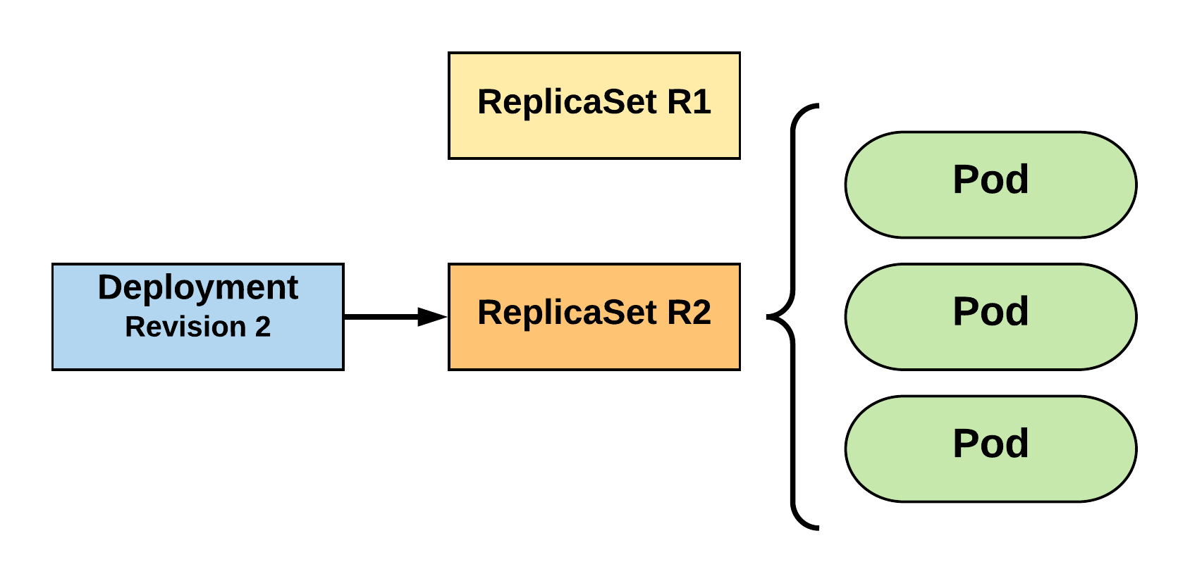
RollingUpdate Deployment
Updated to new deployment revision completed.
R1 pod-template-hash: 676677fff
R2 pod-template-hash: 54f7ff7d6d
$ kubectl get replicaset
NAME DESIRED CURRENT READY AGE mydep-54f7ff7d6d 3 3 3 15s
mydep-6766777fff 0 0 0 5h
$ kubectl get pods
NAME READY STATUS RESTARTS AGE
mydep-54f7ff7d6d-9gvll 1/1 Running 0 12s
mydep-54f7ff7d6d-cqvlq 1/1 Running 0 10s
mydep-54f7ff7d6d-gccr6 1/1 Running 0 7s
Notes:
Until the previous revision is at 0
ReplicaSet will remain around, but it will have 0 replicas. How many stay around are based off our revision history limit

Slide 68
Kubernetes Services

Slide 69
Services
A kubernetes Service is an abstraction which defines a logical set of Pods and a policy by which to access them
Unified method of accessing the exposed workloads of Pods
Durable resource
Uses kube-proxy to provide simple load balancing

Slide 70
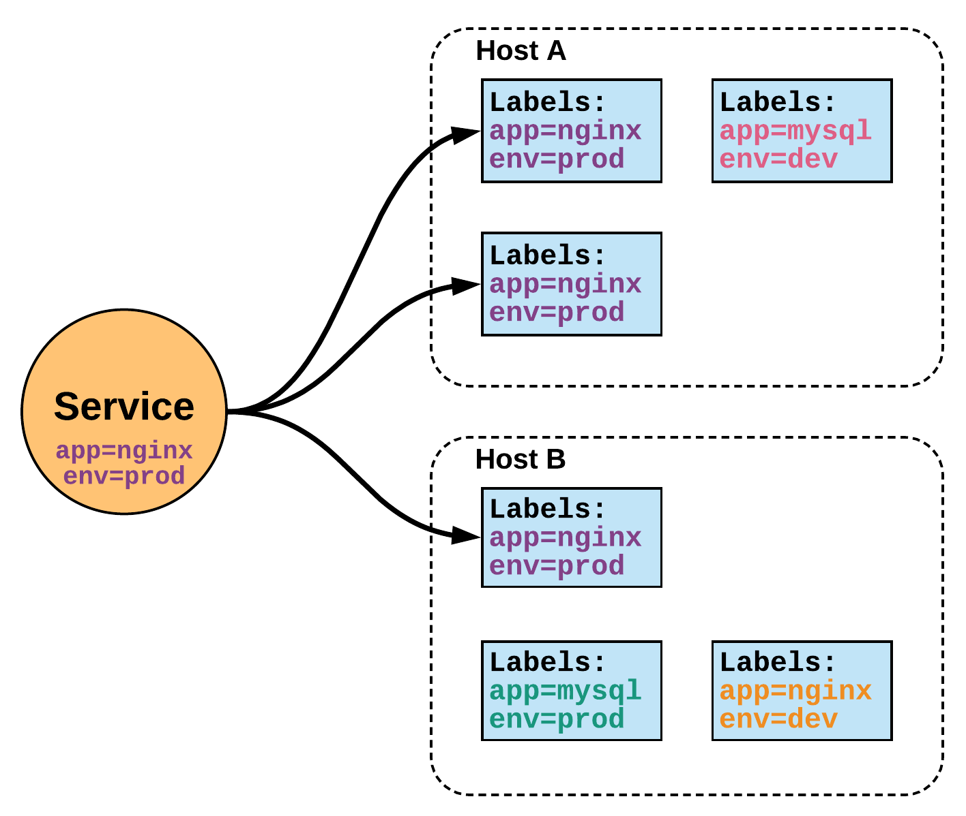
Services (Proxy)
Unified Method of Accessing Exposed Workloads of Pods
Internal Load Balancer to Your Pod(s)
Create a service, reference the pods, for e.g. 3, and (internally) it will load balance across the 3.

Slide 71
Service Types
4 Major Publishing Service Types
ClusterIP (default)
NodePort
LoadBalancer
Ingress

Slide 72
ClusterIP Service
ClusterIP is an internal LB for your application
Exposes a service on a strictly cluster internal virtual IP

Slide 73
NodePort Service
Exposes the service on each Node’s IP at a static port (the NodePort)
NodePort behaves just like ClusterIP, except it also exposes the service on a (random or specified) port on every Node in your cluster.
Port can either be statically defined, or dynamically taken from a range between 30000-32767.
You’ll be able to contact the NodePort service, from outside the cluster, by requesting <NodeIP>:<NodePort>

Slide 74
LoadBalancer Service
Exposes the service externally using a cloud provider’s load balancer
NodePort and ClusterIP services, to which the external load balancer will route, are automatically created.

Slide 75
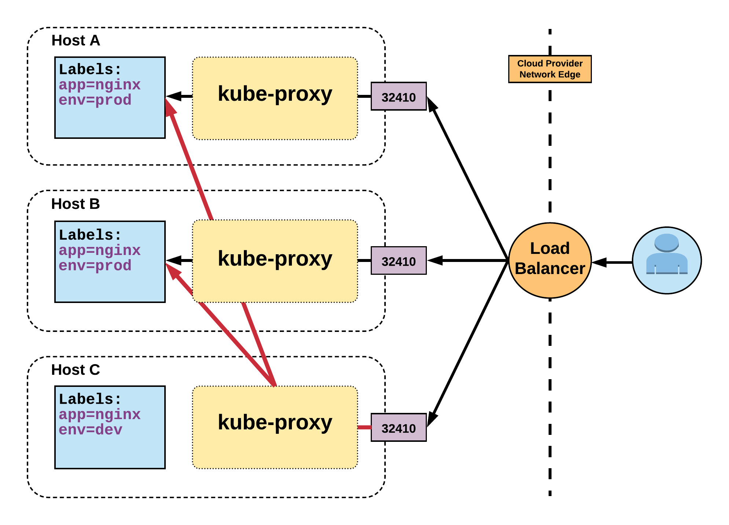
LoadBalancer Service Cont.
Name: example-prod
Selector: app=nginx,env=prod
Type: LoadBalancer
IP: 10.96.28.176
LoadBalancer Ingress: 172.17.18.43
Port: <unset> 80/TCP
TargetPort: 80/TCP
NodePort: <unset> 32410/TCP
Endpoints: 10.255.16.3:80, 10.255.16.4:80

Slide 76
ExternalName Service
Maps the service to the contents of the externalName field (e.g. app1.prod.example.com)
ExternalName is used to reference endpoints OUTSIDE the cluster.
Creates an internal CNAME DNS entry that aliases another.

Slide 77
Ingress
An API object that manages external access to the services in a cluster, typically HTTP
Traffic routing is controlled by rules defined on the ingress resource
An ingress does not expose arbitrary ports or protocols
In order for the ingress resource to work, the cluster must have an ingress controller running

Slide 78
Lab 7 – Ingress
Create 3 Deployments Using NodePort
Create Ingress Controller
Create Ingress
Expose Through Ingress

Slide 79
Kubernetes Networking

Slide 80
Kubernetes Networking
Pod Network
Cluster-wide network used for pod-to-pod communication managed by a CNI (Container Network Interface) plugin.
Service Network
Cluster-wide range of Virtual IPs managed by kube-proxy for service discovery.

Slide 81
Kubernetes Networking
Unlike Docker, every pod gets its own cluster wide unique IP, and makes use of the CNI plugin
Services are a separate range of static non-routable virtual IPs that are used like an internal LB or static IP
Service IPs are special and can’t be treated like a normal IP, they are a ‘mapping’ stored and managed by kube-proxy
Pod IPs are pingable
Service IPs are not

Slide 82
Container Network Interface (CNI)
Pod networking within Kubernetes is plumbed via the Container Network Interface (CNI).
Functions as an interface between the container runtime and a network implementation plugin.
CNCF Project
Uses a simple JSON Schema.
CNI runtime focuses solely on container lifecycle connectivity

Slide 83
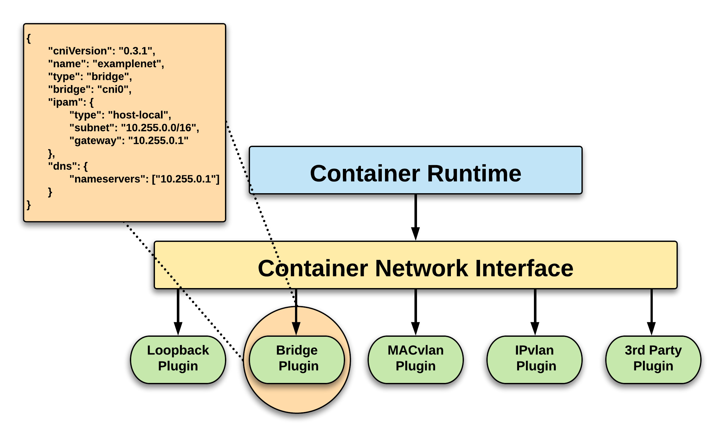
CNI Overview

Slide 84

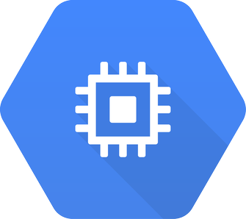







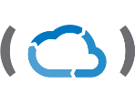

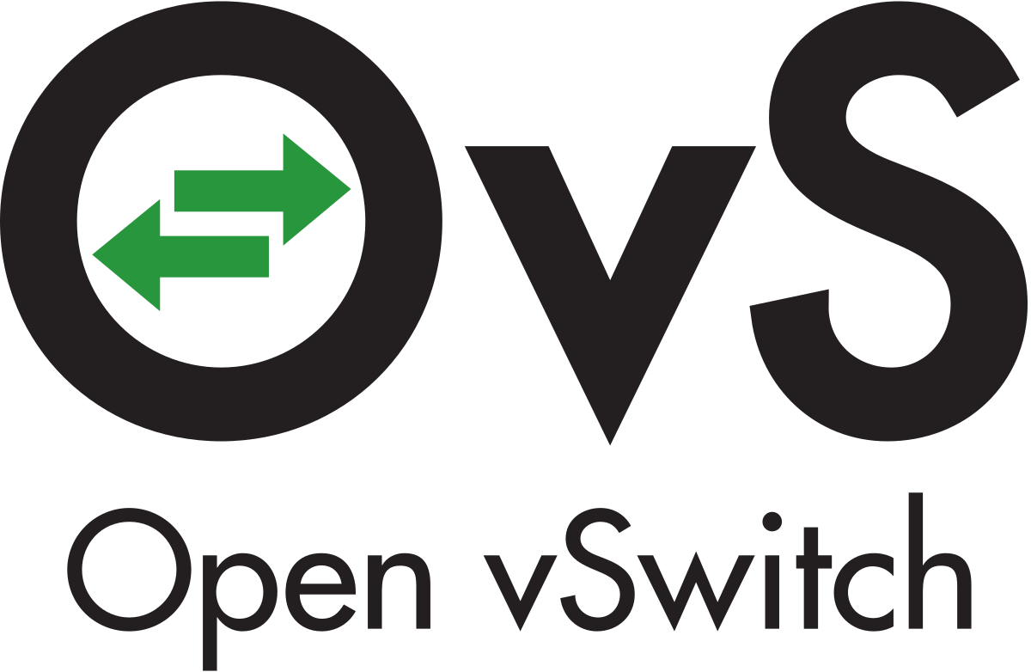
CNI Plugins
Amazon ECS
Calico
Cillium
Contiv
Contrail
Flannel
GCE
kube-router
Multus
OpenVSwitch
Romana
Weave

Slide 85
Fundamental Networking Rules
All containers within a pod can communicate with each other unimpeded.
All Pods can communicate with all other Pods without NAT.
All nodes can communicate with all Pods (and vice-versa) without NAT.
The IP that a Pod sees itself as is the same IP that others see it as.
Pods are given a cluster unique IP for the duration of its lifecycle.

Slide 86
Fundamental Networking Rules - II
Container-to-Container
Containers within a pod exist within the same network namespace and share an IP.
Enables intrapod communication over localhost.
Pod-to-Pod
Allocated cluster unique IP for the duration of its life cycle.
Pods themselves are fundamentally ephemeral.

Slide 87
Fundamental Networking Rules - III
Pod-to-Service
managed by kube-proxy and given a persistent cluster unique IP
exists beyond a Pod’s lifecycle
kubernetes creates a cluster-wide IP that can map to n-number of pods
External-to-Service
Handled by kube-proxy.
Works in cooperation with a cloud provider or other external entity (load balancer).

Slide 88
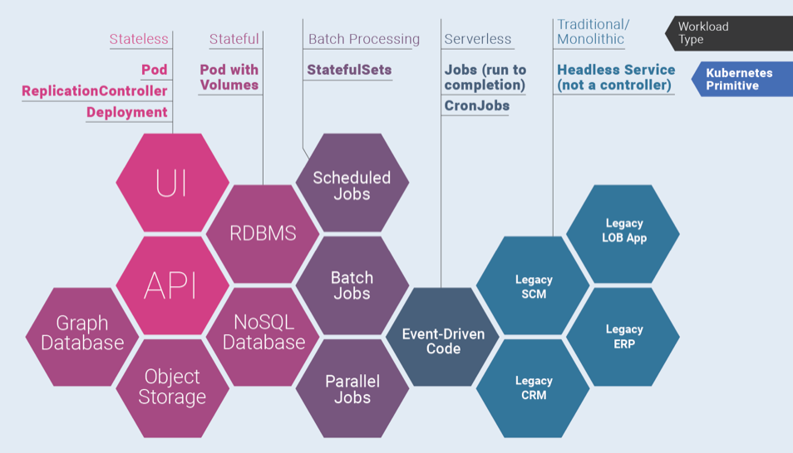
Mapping Workloads to K8 Primitive

Slide 89
Horizontal Pod Autoscaling (HPA)

Slide 90
Horizontal Pod Autoscaler
Natively Scale Number of Replicas of
Deployment
StatefulSet
Depending on Various Metrics
CPU Usage
RAM Usage
Custom Metric
Easier to Implement for Stateless Components
Trickier for Stateful Components Such as Databases
Use Active/Active Replication

Slide 91
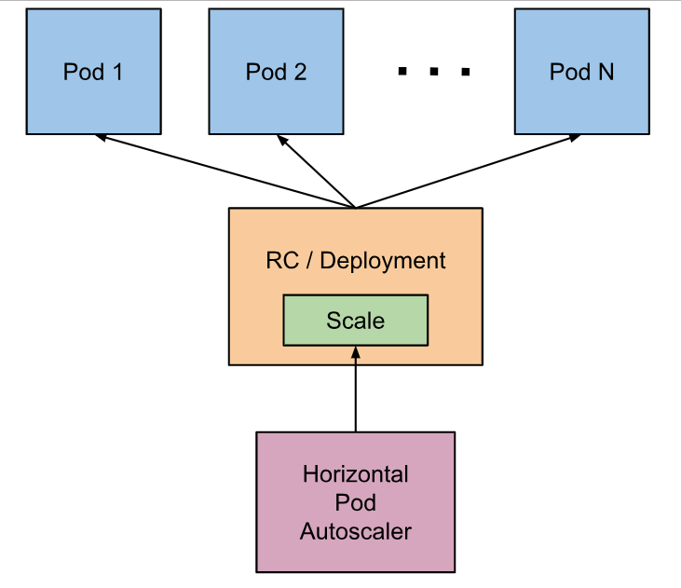
Horizontal Pod Autoscaling (HPA)
The Horizontal Pod Autoscaler automatically scales the number of pods in a replication controller, deployment or replica set based on observed CPU utilization or other metrics
The Horizontal Pod Autoscaler is implemented as a Kubernetes API resource and a controller
https://kubernetes.io/docs/tasks/run-application/horizontal-pod-autoscale/

Slide 92
Lab 8 – Auto Scale Pods
Deploy your app
Add load on your app
Number of Pods will go up, automatically, based on load
Reduce load on your app
Number of Pods will go down, automatically, based on load

Slide 93
Monitoring Kubernetes

Slide 94
Monitoring Challenges for Kubernetes
Many, smaller pieces to monitor
Keeping track of pods and containers
Health of deployed applications and containers
Availability of resources in a deployment/cluster

Slide 95
Monitoring Kubernetes – Data Sources
K8 Hosts Running Kubelet
K8 Process i.e. Kubelet Metrics : give you details on a Kubernetes node and the jobs it’s running
Metrics for apiserver
kube-scheduler
kube-controller-manager
Kubelet’s Built-in cAdvisor : collects, aggregates, processes, and exports metrics for your running containers
Kube-state Metrics : gives you information at the cluster level

Slide 96
Metrics Server
Cluster-wide aggregator of resource usage data
Metric server collects metrics from the Summary API, exposed by kubelet on each node
5000 nodes clusters with 30 pods per node, supported by kubernetes 1.6
To collect 10 metrics from each pod per node
10 x 5000 x 30 / 60 = 25000 metrics per second by average
This required a new server instead of API service, hence metrics server was created

Slide 97
Lab 9 – Monitor K8
Uses Prometheus & Grafana
Monitor Nodes
Monitor Pods
Monitor Deployments
And Much More

Slide 98
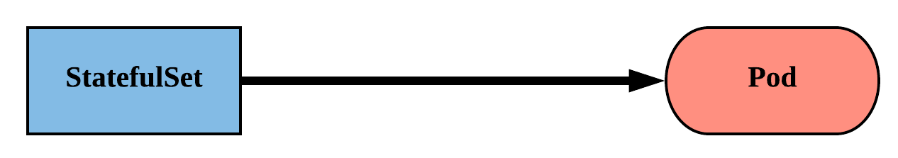
StatefulSet
Tailored to managing Pods that must persist or maintain state.
Pod identity including hostname, network, and storage WILL be persisted.
Assigned a unique ordinal name following the convention of ‘<statefulset name>-<ordinal index>’.

Slide 99
StatefulSet
Naming convention is also used in Pod’s network Identity and Volumes.
Pod lifecycle will be ordered and follow consistent patterns.
Revisions are managed via a controller-revision-hash label

Slide 100
Lab 10 & 11 – Putting it all Together
Deploy WordPress on K8
Uses Persistent Volume and Persistent Volume Claims
Uses ConfigMap and Secrets

Slide 101
Kubernetes Best Practices
Configure Health Checks
Use Multiple Clusters
Begin with One Container in One Pod
Keep Your Images Small

Slide 102
Path Forward
Start with a managed service
Docker Documentation (Docker.com)
K8 Documentation (Kuberntes.IO)
Automate Image Creation, Storage and Deployment
Create and Use Official Image Repository
Use Docker Swarm for Smaller Workloads
Start with Stateless Applications

Slide 103
This concludes Chapter 3 Container Orchestration with Kubernetes

